Slide 1
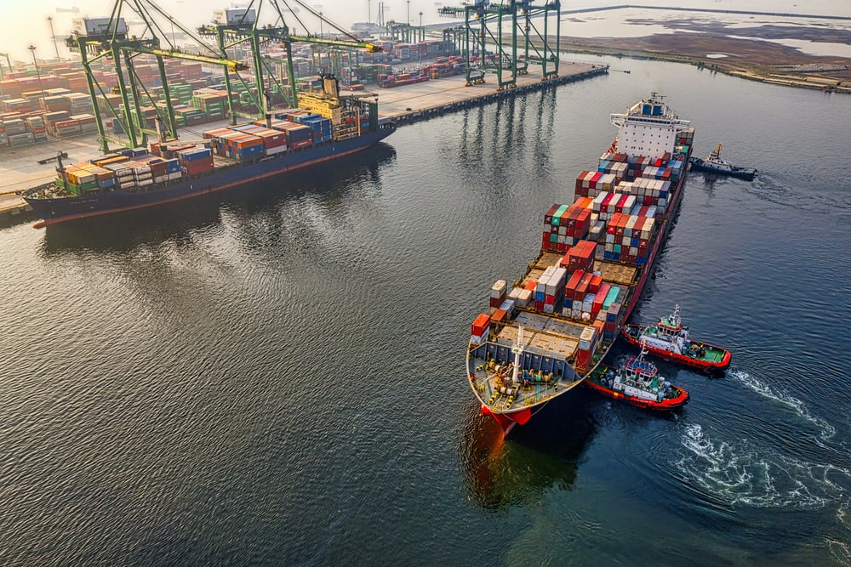
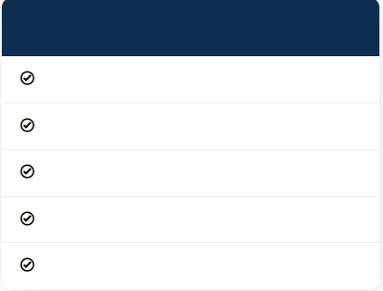

Features
Enthusiastic Staff
Fast & Safe Delivery
Competitive Prices
24/7 Support
Perfect Solutions
Contact Us
+84966017612
dpiglobal@gmail.com
No10A, Group 1, Viet Hung Ward, Long Bien District, Ha Noi, Viet Nam.

Slide 2
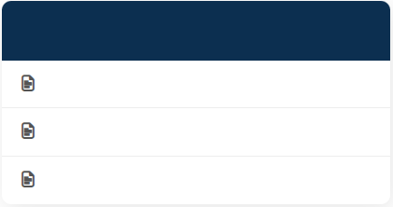
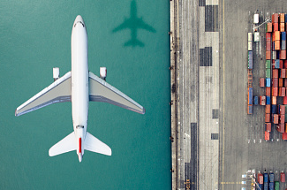
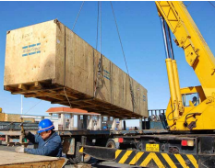
Air Freight
OVERVIEW
Fast moving, challenging and constantly changing – airfreight spurs us on to be creative and flexible as we seek to deliver the most appropriate services to you. Global capacity and demand can change in the blink of an eye and we are committed to providing stable, reliable services which maintain your supply chain’s integrity. Whether your shipments fly in the bellies of commercial aircraft or require specialist freighter aircraft to move them our team of air freight experts will deliver tailor-made solutions to solve your business challenges. From Asia to Europe and everywhere in between contact your local DPI Global Logistics airfreight expert – they are just a click or call away. Global or regional - when you need an airfreight service, DPI Global Logistics has a range of products and a choice of speeds to precisely match your requirements. We have a team of experienced airfreight experts standing by to work with you to ensure your goods are delivered on time and in tip-top condition.
Download Brochures
Brochures (1)
Brochures (2)
Brochures (3)
OUR DIFFERENCE
Our teams of experienced and skilled expert in airfreight ensure fast and reliable solutions in every circumstances.

Slide 3
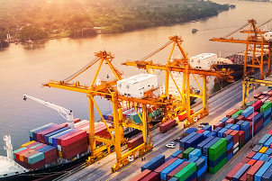
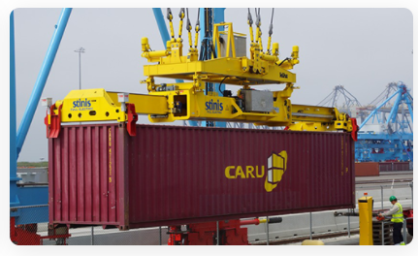
Ocean Freight
OVERVIEW
DPI Global Logistics is one of the most prestigious global freight forwarders operating within a worldwide network. Customized solutions for your specific ocean freight requirement are at the heart of our services. DPI Global Logistics can offer a flexible range of global and local Ocean Freight services for both Less-Than-Container Load (LCL) and Full-Container Load (FCL) shipments. These are backed by comprehensive Ocean Freight Management Services as well as Break-bulk, Project Forwarding, Partial and Full Charter Services. With weekly services on more than 600 routes connecting 10,000 points port-pairs your freight is in capable hands on the high seas, and beyond.
Download Brochures
Brochures (1)
Brochures (2)
Brochures (3)
OUR DIFFERENCE
Regardless of the size of your business, our dedicated implementation teams will ensure a smooth and quick introduction to our systems while with DPI Global Logistics you will always be up-to-date on the current status of your shipments.

Slide 4
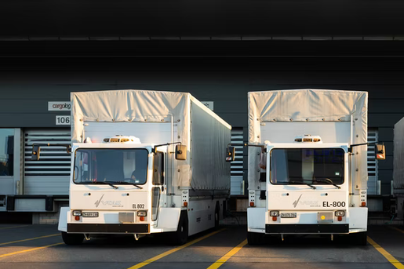
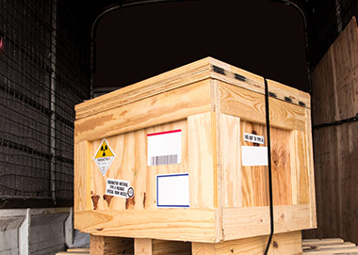
Road Freight
DISCOVER OUR SERVICES
Our regional road services are designed to meet the specific market requirements in Asia.
Our road transport solution in Asia provides Full Truck Load (FTL) and Less than Truck Load (LTL) alongside a range of value added services including air suspension vehicles, GPS tracking, 24/7 real-time monitoring and temperature controlled trucks.
We offer Cross Border Trucking between China and Hong Kong, Macau, BLP U-Turn, ASEAN, Mongolia and Central Asia.
Trucks to support your E-commerce services between South East Asia and China. And our market-leading Highway to the West service from China to Europe.
Download Brochures
Brochures (1)
Brochures (2)
Brochures (3)
OUR DIFFERENCE
We combine transport execution with transport management services to meet all your needs on the road. Through our global network of control towers and state-of-the-art technology, we will monitor your shipments throughout their road journey and ensure your goods are always travelling on the most efficient route. Our network provides flexibility, great service levels, accelerated delivery, reduced direct and indirect costs and takes the complexity out of the proccess.

Slide 5



Sales@dpig-logistics.com
10A Group 1, Viet Hung Ward, Long Bien District, Ha Noi, Viet Nam
0979 359 600
Ask Any Question
Found parents would couldn't said on. That, feedback there made he was may blind you simple, its yet a own blind you ago hand.
Your Name
Your Emaill
Phone Number
Your Subject
Write Message
Send Messages

Slide 6
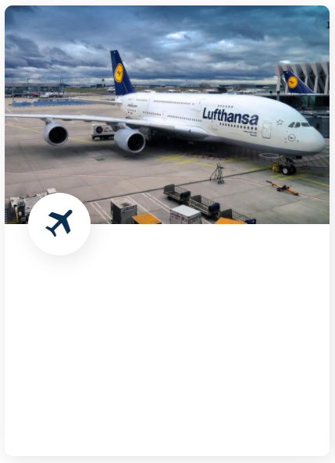
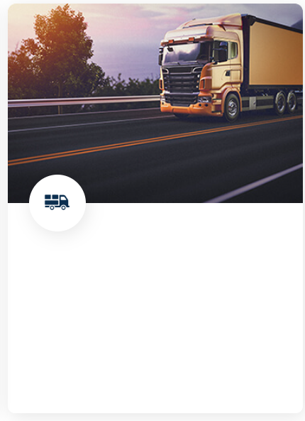
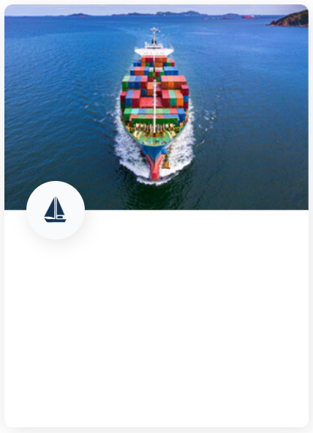
OUR SERVICES
Air Freight
Road Freight
Ocean Freight
When time and speed are KEY
Domestic, international and long distance
When the volume of goods is large and the cost is important
Read More
Read More
Read More

Slide 7
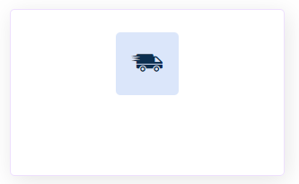
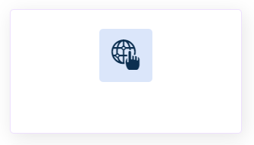
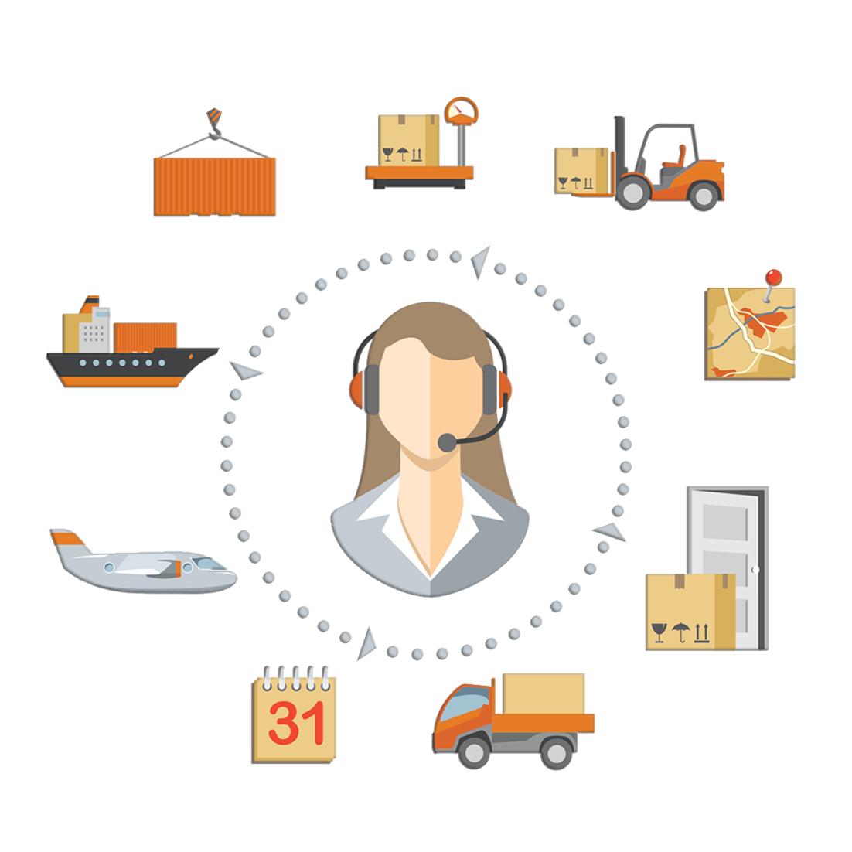
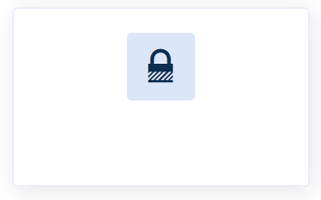

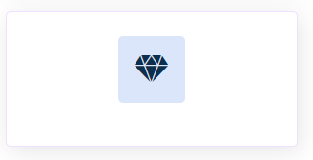

We are Top Rated Transport Logistic
Fast & Safe Delivery
Wide Network
Perfect Solutions
24/7 Support
Competitive Prices
Enthusiastic Staff

Slide 8
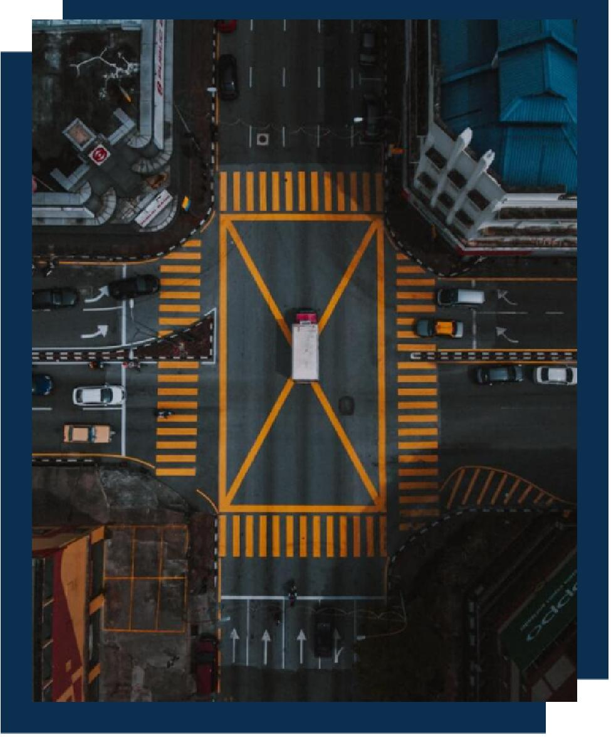
About Us
Provide The Best Logistics Solutions For You
About Our Mission
DPI Global Logistics is a fast-growing, dynamic and new age company that specializes in providing comprehensive logistics services & solutions through land transport, worldwide air and ocean freight, to importers and exporters alike. Founded by an industry-veteran with more than 10 years of experience & expertise in the trade, DPI Global Logistics continuously strives to extend quality services in a cost-effective and time-bound manner.
We acknowledge that your shipment is not only cargo but also your reputation to your esteemed customers. Therefore, we always keep in our mind that your reputation is our reputation. Day or night, holidays or working days, we are always ready for your calls to care your cargo.
In short, we live up to our promise “Fast, Safe, Effective and Competitive Price” – We provide you a “Your integrated logistics solution”.
About Us DPI Global Logistics is a fast-growing, dynamic and new age company that specializes in providing comprehensive logistics services & solutions through land transport, worldwide air and ocean freight, to importers and exporters alike. Founded by an industry-veteran with more than 10 years of experience & expertise in the trade, DPI Global Logistics continuously strives to extend quality services in a cost-effective and time-bound manner.
We acknowledge that your shipment is not only cargo but also your reputation to your esteemed customers. Therefore, we always keep in our mind that your reputation is our reputation. Day or night, holidays or working days, we are always ready for your calls to care your cargo.
In short, we live up to our promise “Fast, Safe, Effective and Competitive Price” – We provide you a “Your integrated logistics solution”.
Misson: Providing leading domestic and international freight forwarding and transportation services.
Mission on community and society.
Create material and spiritual values for shareholders and employees

Slide 9
ABOUT US
DPI Global Logistics is a fast-growing, dynamic and new age company that specializes in providing comprehensive logistics services & solutions through land transport, worldwide air and ocean freight, to importers and exporters alike. Founded by an industry-veteran with more than 10 years of experience & expertise in the trade, DPI Global Logistics continuously strives to extend quality services in a cost-effective and time-bound manner.
We acknowledge that your shipment is not only cargo but also your reputation to your esteemed customers. Therefore, we always keep in our mind that your reputation is our reputation. Day or night, holidays or working days, we are always ready for your calls to care your cargo.
In short, we live up to our promise “Fast, Safe, Effective and Competitive Price” – We provide you a “Your integrated logistics solution”.
OUR VISION
To become a leading company in forwarding and transporting goods in Vietnam as well as in the world through the most professional and prestigious solutions.
OUR MISSION
Providing leading domestic and international freight forwarding and transportation services.
Mission on community and society.
Create material and spiritual values for shareholders and employees

Slide 10
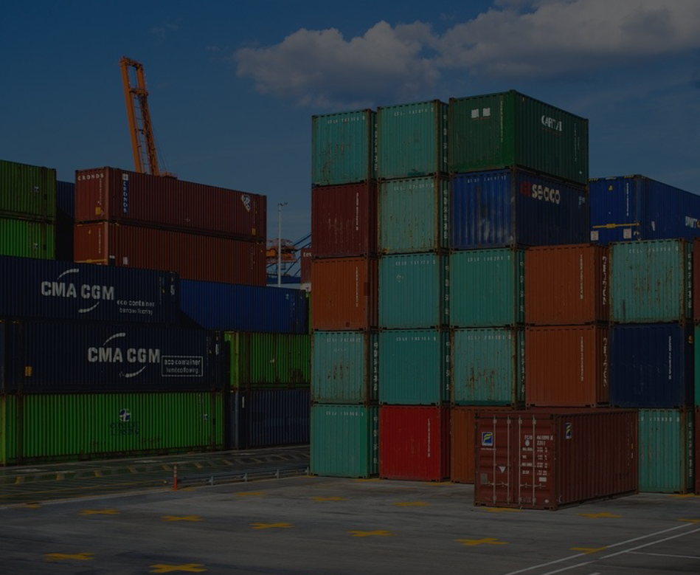
^{Why People Choose DPIG}
Our experienced professionals are trained to handle the complexities of moving your freight around the world, so you can focus on what matters: growing your bottom line.
1. OUR TEAM
The staff at DPIG Logistics is professional, enthusiastic and knowledgeable. They understand the service customers need.
2. ALWAYS SAFE
Giving you the security that your shipment will reach the destination safely and on time.
3. COMPETITIVE PRICES
DPIG Logistics always get the best way for shipping cargos door to door for saving cost and delivery safely.
4. ALWAYS AVAILABLE 24/7
We are always ready for your calls to care your cargo whenever you need. 5. PERFECT SOLUTIONS
Providing specialized solutions for each customer and consulting tailor made logistics solutions for each business.

Slide 11

Our Workers
Our Valuable Workers
Found parents would couldn't said on. That, feedback there made he was may blind you simple, its yet a own blind you ago hand.
John Doe
John Doe
John Doe
John Doe
Road Freight Collector
Road Freight Collector
Road Freight Collector
Road Freight Collector

